Slide 1
Wikidata.lib

Slide 2
Agenda
Introduction to Wikidata
Wikidata Prozess
Generelle Aufgabe: Was ist Wikidata? Wikidata verbessern(Aufgaben)
Demo - vorher/nachher
Verfahren
- leere Objekte, volle Objekte, klassifizierer
Datenerfassung, vorberechnung
Suggestion berechnung mit mysql
Rapidprototyping/Entwicklungsprozess

Slide 3
Wikidata
What is Wikidata?
What is its purpose?

Slide 4
Improve it(Liste v Aufgaben)
List of initial tasks

Slide 5
Projects
PubSubHubub
Property Suggester

Slide 6
Meta meta meta
Gerrit, Labs, Accounts, waiting time, review process, architecture…
Mailing List (active community)

Slide 7
Demo
Notes:
Auf UI hinweisen, im Vergleich zum alten

Slide 8
Property Process
How did we implement it?
Rapid Prototyping
Weekly hangouts (+ personal meetings) → instant review→ incremental improvement
3 wikidata contacts: Lydia (Product Manager), Daniel (Developer) and Abraham (Project Manager)

Slide 9
Mögliche Vorschlagstypen
Empty Item (new Item) – task : find frequently used classifiers
Existing Item with list of preexisting properties
More detailed suggestions (values, qualifier etc.)
Suggest misfits
Future plans

Slide 10
Workflow
XML/JSON Dump
Feature CSV
PHP Suggester
Suggestions
Dump parser
MySQL Table
Calculate Correlations

Slide 11
Workflow
XML/JSON Dump
Feature CSV
PHP Suggester
Suggestions
Dump parser
MySQL Table
Calculate Correlations
XML Dump (25GB)
Contains all Wikidata pages and JSON data in the <text> tag
Convert to CSV
Python
XML Stream Parser (xml.etree.cElementTree)
JSON Parser (ujson)
30minutes
CSV (1.7GB)
Q1,31,wikibase-entityid,Q223557
Entity: Q1 (Universe)
Property: 31 (instance of)
Property Type: wikibase-entityid
Value: Q223557 (Physical Object)

Slide 12
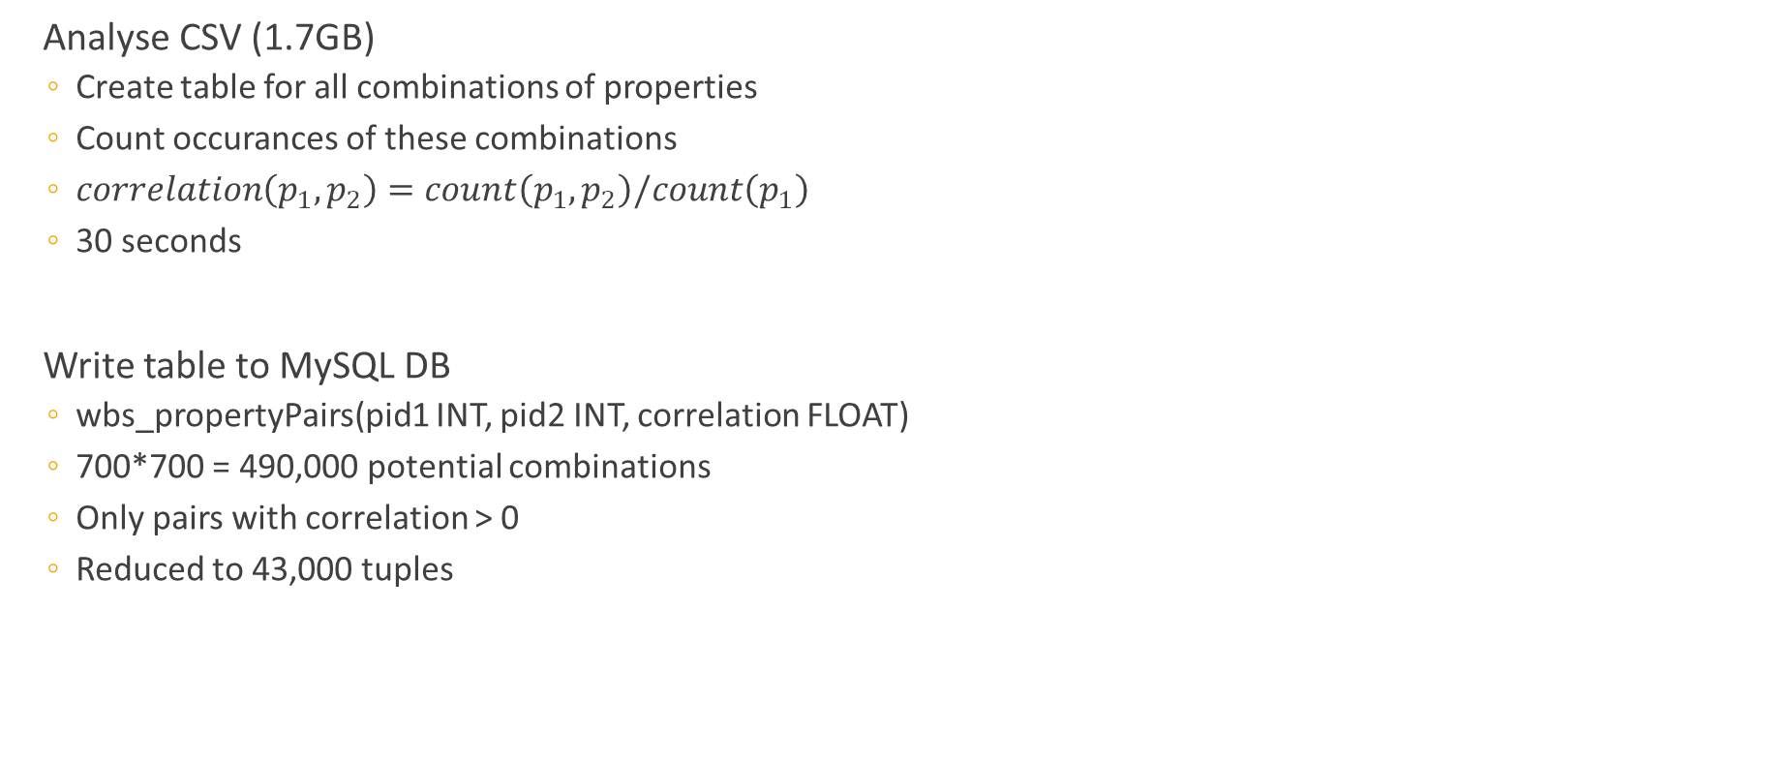
Workflow
XML/JSON Dump
Feature CSV
PHP Suggester
Suggestions
Dump parser
MySQL Table
Calculate Correlations
Analyse CSV (1.7GB)
Create table for all combinations of properties
Count occurances of these combinations
$correlation\left(p_{1},p_{2}\right)=count\left(p_{1},p_{2}\right)/count\left(p_{1}\right)$
30 seconds
Write table to MySQL DB
wbs_propertyPairs(pid1 INT, pid2 INT, correlation FLOAT)
700*700 = 490,000 potential combinations
Only pairs with correlation > 0
Reduced to 43,000 tuples

Slide 13
Workflow
XML/JSON Dump
Feature CSV
PHP Suggester
Suggestions
Dump parser
MySQL Table
Calculate Correlations
MySQL Table
wbs_propertyPairs(pid1 INT, pid2 INT, correlation FLOAT)
Provide Suggestions
Input: Entity E
with a list of properties $L
$size = count($L)
SELECT pid2, sum(correlation)/$size AS cor FROM wbs_PropertyPairs WHERE pid1 IN $L AND pid2 NOT IN $L GROUP BY pid2 HAVING sum(correlation)/$size > $threshold ORDER BY cor DESC LIMIT $limit

Slide 14
Future plans

